Slide 1
Managing the Linux Boot Process
Configure Linux Boot Components
Configure GRUB 2

Slide 2

Topic A: Configure Linux Boot Components
Exam Objectives:
1.1 Explain Linux boot process concepts.
1.4 Given a scenario, manage storage in a Linux environment.

Slide 3
Booting
The process of starting or restarting a computer and loading an operating system for the user to access.
Boot environment reads a program in ROM.
Program executes operations in RAM to bootstrap OS.
Makes it available for use.
Linux must go through boot process to function.
You can configure various details of this process.

Slide 4
Boot Loader
A small program stored in ROM that loads the kernel from a storage device, and then starts the operating system.
Boot environment reads loader from ROM.
Boot loader executes operations to start boot process.
Can protect boot process with a password.
Can load multiple OSes into memory.
User must choose at boot.

Slide 5
Boot Loader Components
Component | Description
Boot sector program | First component of boot loader. Loaded by boot environment on startup with fixed 512-byte size. Main function is to load second stage.
Second stage boot loader | Loads OS and contains kernel loader.
Boot loader installer | Controls installation of drive sectors. Coordinates activities of boot sector and boot loader.

Slide 6
BIOS (Slide 1 of 2)
A standard for firmware interfaces that is stored on a computer motherboard's ROM chip.
BIOS is first to run when computer is powered on.
Can test various hardware components.
Also runs a boot loader to start an OS.
Has access to various hardware input devices.
You can make hardware-level changes through the BIOS.
Was the dominant standard for several decades.
Notes:
Teaching Tip: Consider pointing out that, at the BIOS level, the operating system hasn't come into play yet.

Slide 7
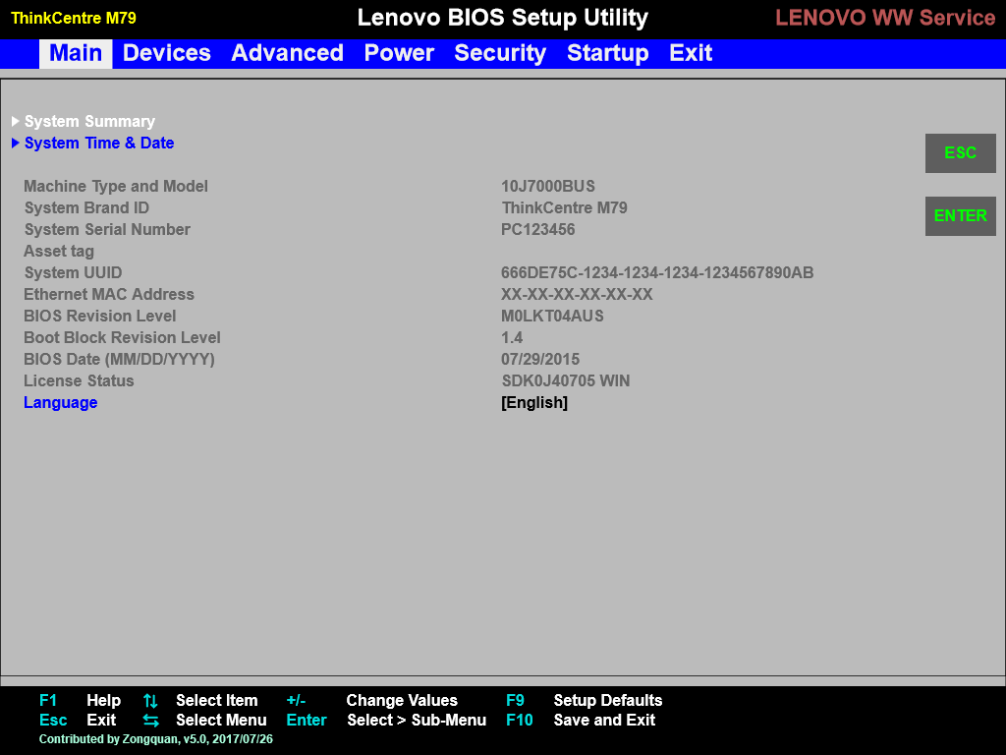
BIOS (Slide 2 of 2)

Slide 8
UEFI
Firmware technology that has largely replaced BIOS as the dominant option interface.
Advantages over BIOS:
Runs faster.
Can operate with more memory.
Can access much larger storage drives.
Can access more hardware types.
Has improved security.
Most new motherboards/PCs ship with UEFI.
Also provides environment to execute boot loader.

Slide 9
Additional Boot Options
Boot Option | Description
Boot from ISO | System image used to package and distribute OS files. Users can boot/install from ISO. Image typically written to disc/USB drive.
PXE | Enables clients to retrieve boot data from network server. Client searches for DHCP servers with PXE services. Servers transfer boot files over TFTP.
Boot from HTTP/FTP | Client can acquire boot data over HTTP/FTP. Faster, more reliable, more secure than TFTP. Open source PXE solutions support these protocols.
Boot from NFS | Client mounts NFS share rather than store files locally. Retrieves share from NFS server. DHCP/TFTP can be used to communicate boot data.

Slide 10
Sectors (Slide 1 of 2)
The smallest unit of storage read from or written to a drive.
Stores 512 bytes of data by default.
For HDDs, collection of sectors is called a track.
Number of sectors in a track varies.
So does capacity.
You can modify sector size when formatting the drive.

Slide 11
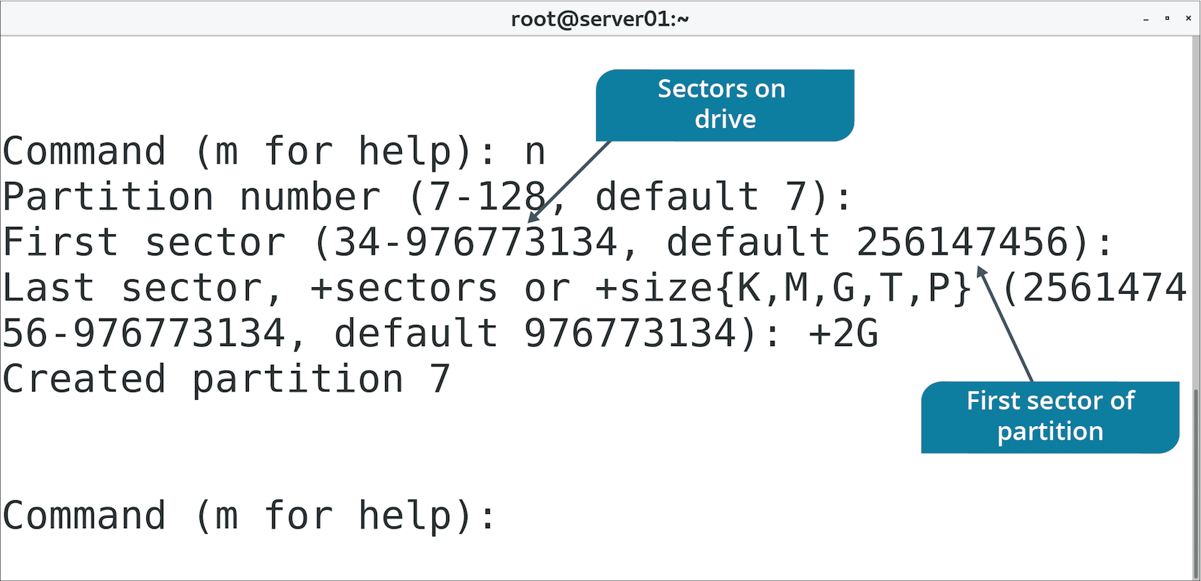
Sectors (Slide 2 of 2)

Slide 12
MBR
The first physical sector on a storage drive and a type of partition structure.
Boot sector contains boot loader.
Also contains partition table of drive.
Determines what sectors are available to each partition.
Determines which sector is bootable and which are not.
Dominant for many years in multiple OSes.
Disadvantages:
Max space of drive is 2 TBs.
Max of 4 primary partitions.
Boot data stored in only one sector.

Slide 13
GPT
A modern partition structure that is meant to replace MBR.
Makes up for MBR's shortcomings.
Part of UEFI standard.
Every partition is assigned a GUID.
Storage space and partition numbers are practically limitless.
Any limits are likely to be imposed by OS or file system.
Stores boot data in multiple locations.
Enhances redundancy.
If one location is corrupted, GPT can recover data using a copy.
Prefer using GPT over MBR.

Slide 14
initrd
The root file system that is temporarily loaded into memory upon system boot.
Loads along with kernel.
Enables system to start in two phases:
System is booted with minimal modules required to load main root file system.
Temporary file system is removed so user-space booting can continue.
Useful because many variables complicate boot process.
Kernel needs to load device driver modules.
Kernel needs to load main root file system.
Root file system could use storage methods requiring advanced setup.
The initrd handles this.
No need to hardcode behavior in kernel.
Notes:
Teaching Tip: Consider pointing out that, at this point in the process, the computer has an operating system.

Slide 15
The initrd Image
An archive file containing all the essential files that are required for booting the operating system.
Can be built or customized.
Include additional modules.
Remove unnecessary modules.
Update existing modules.
Usually stored in /boot directory.

Slide 16
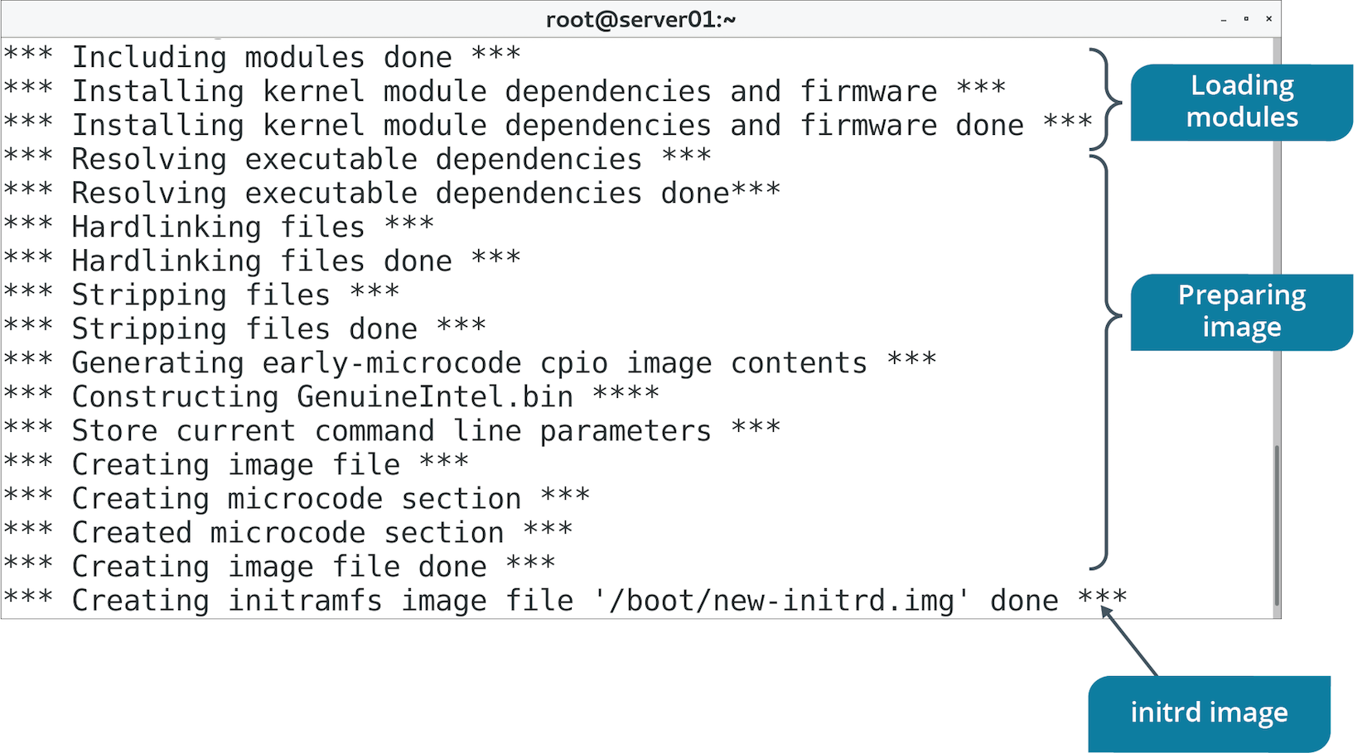
The mkinitrd Command (Slide 1 of 2)
Used to create initrd image.

Slide 17
The mkinitrd Command (Slide 2 of 2)
Option | Used To
--preload={module name} | Load module in image before loading other modules.
--with={module name} | Load module in image after loading other modules.
-f | Overwrite existing image file.
--nocompress | Disable compression of image.

Slide 18
The /boot/ Directory
Option | Description
/boot/grub/ | Contains config files for GRUB boot loader. /boot/grub2/ is for GRUB version 2.
/boot/efi/ | Contains boot files for EFI system partition (ESP). Boot loader, device driver, system app files executed by UEFI. Boot loader files named with .efi extension.
/boot/initramfs | initramfs image; alternative to initrd. Doesn't require special driver to be compiled with kernel. Dynamically sizable archive.
/boot/vmlinuz | Compressed executable of Linux kernel. Boot loader loads file into memory during boot. vmlinux is non-compressed version used for debugging.
Notes:
Teaching Tip: GRUB will be discussed in more depth in the next topic.

Slide 19
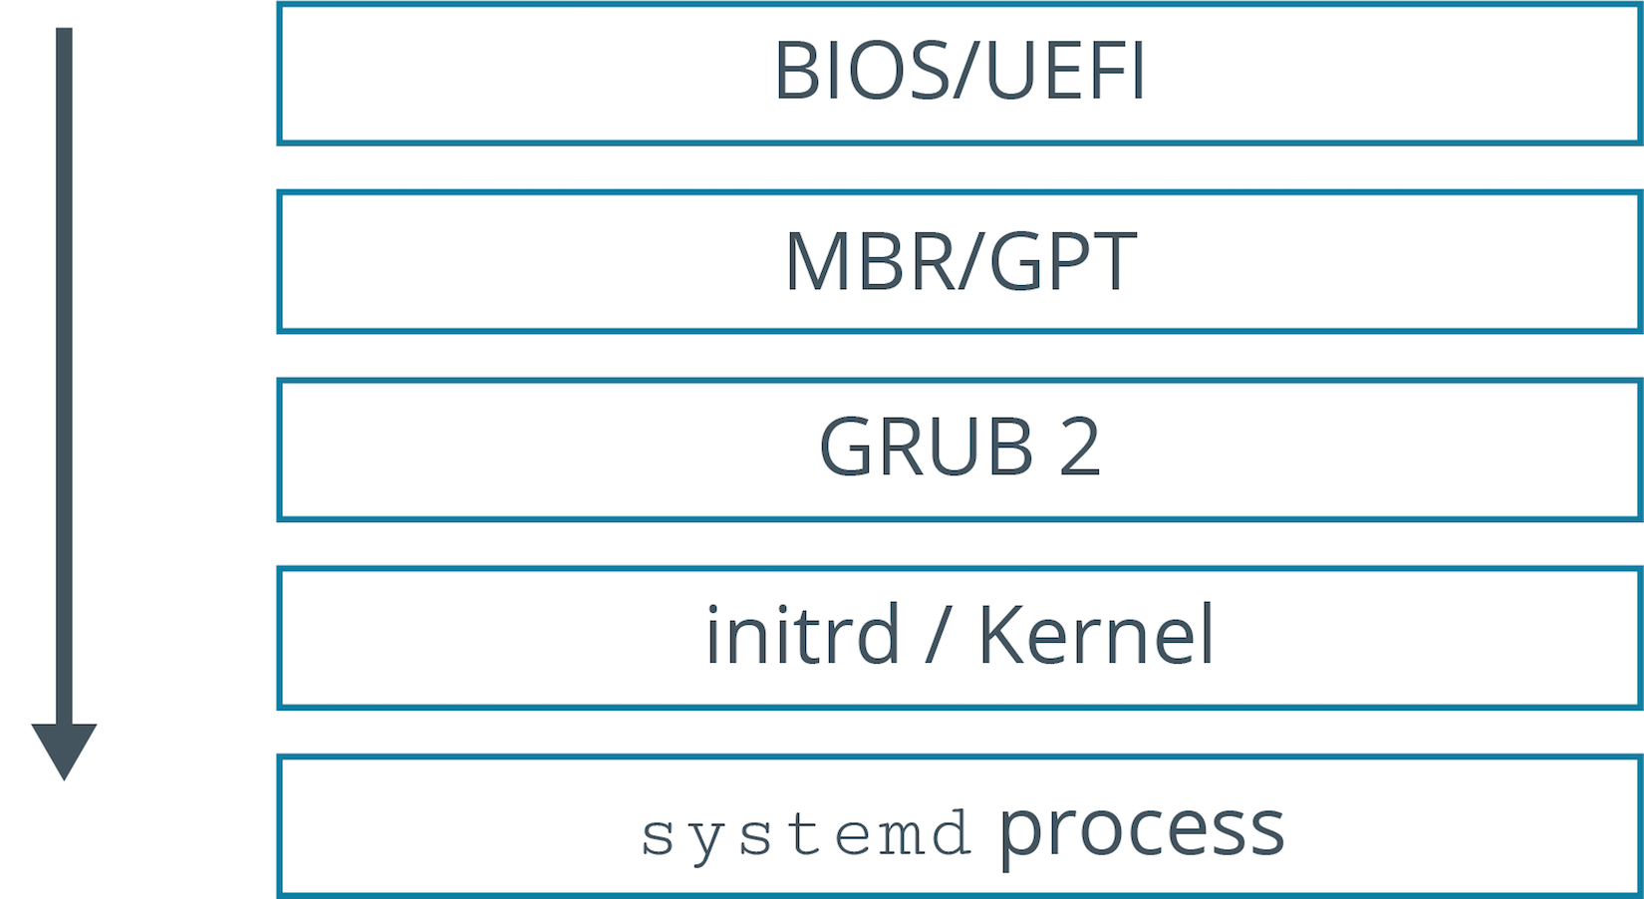
The Boot Process (Slide 1 of 2)
Notes:
Teaching Tip: Consider pointing out that this is where the previously discussed concepts fit together.
Teaching Tip: Display managers and targets will be discussed in more depth in the next lesson.

Slide 20
The Boot Process (Slide 2 of 2)
Processor checks for BIOS/UEFI firmware.
BIOS/UEFI checks for bootable media.
BIOS/UEFI loads primary boot loader from MBR/GPT partition into memory.
User is prompted to select system to boot; default is booted if no response.
Boot loader loads initrd image into memory and transfers control to kernel.
Kernel configures hardware drivers, decompresses initrd, and mounts it.
Kernel mounts main root partition and executes systemd program.
The system program checks the target and starts various services.
If graphical mode is selected, a display manager is started.
User enters credentials.
System authenticates user and executes profile files.
Shell is started and system is ready for use.

Slide 21
Kernel Panic
A mechanism by which the system detects there has been a fatal error and responds to it.
Fatal errors result in an unstable or unusable system.
Panic handlers display errors to user and dump kernel memory to a file.
Panic handlers will reboot automatically or wait for user.
Can happen for many reasons, but usually during boot process.
Common causes:
Kernel is corrupt.
systemd program was not executed on boot.
Kernel cannot find/mount root file system.
Malfunctioning/incompatible hardware loaded on boot.

Slide 22
Discussing the Linux Boot Process

Slide 23
Activity 7-1: Discussing the Linux Boot Process
Your coworkers are trying to decide between using UEFI or legacy BIOS for some of your systems. They ask you for your opinion. What are the advantages of UEFI that you can tell your coworkers?
ANSWER:
UEFI is faster, can address a larger amount of memory, can access huge drives, can use more hardware types, and has improved security over BIOS.

Slide 24
Activity 7-1: Discussing the Linux Boot Process
MBR is to BIOS as __________ is to UEFI.
ANSWER:
GPT. GPT is part of the UEFI standard and is the successor to MBR.

Slide 25
Activity 7-1: Discussing the Linux Boot Process
What is the importance of the initrd phase of the boot process?
ANSWER:
The initrd enables the system to be started in two phases. In the first phase, the system is booted with the minimal set of modules required to load the main, or permanent, root file system. In the second phase, when the main root file system is mounted, the previously mounted initrd file system is removed and the user space boot process continues.

Slide 26
Activity 7-1: Discussing the Linux Boot Process
You've taken a new position as a Linux administrator and you discover that every Linux system contains a /boot/efi/ directory. What is the significance of this /boot/efi/ directory?
ANSWER:
Systems with the /boot/efi/ directory use the UEFI boot process rather than the BIOS boot process

Slide 27
Activity 7-1: Discussing the Linux Boot Process
Linux administrators don't enjoy seeing a kernel panic during the boot process because it means that the system won't recover on its own and something serious has happened. What are some possible causes of a kernel panic that occur during the boot process?
ANSWER:
The system has a corrupted kernel, the systemd program didn't execute, the kernel can't find or mount the root file system, or a hardware component has malfunctioned.

Slide 28
Activity: Identifying Linux Boot Components
You need to become more familiar with boot components.
Will help you troubleshoot issues when loading OS onto new machines.

Slide 29
Activity: Creating an initrd Image
Some systems need to boot from NFS.
Kernel on systems doesn't have NFS module by default.
Without this, systems can't mount NFS root share.
You need to create a new initrd image for the kernel.
First you'll create a baseline image.
Notes:
Teaching Tip: If students are curious, you may wish to let them know that $ (uname) is an example of command substitution, which is discussed later in the course.

Slide 30
Topic B: Configure GRUB 2
Exam Objectives:
1.1 Explain Linux boot process concepts.

Slide 31
GNU GRUB
A boot loader developed by the GNU Project that became popular on Unix-like systems.
Enables users to choose which OS/kernel version to boot from.
Original version was primary boot loader for Linux distros.
Has several limitations.
Phased out in favor of GRUB version 2.
Original is called GRUB legacy.

Slide 32
GRUB 2 Improvements
Complete redesign of GRUB.
More control over boot process, devices, and behavior.
Improvements:
Support for non-x86 platforms.
Support for live booting.
Support for partition UUIDs.
Support for dynamically loading modules.
Ability to configure boot loader through scripts.
Rescue mode.
Support for custom menus and themes.
GRUB 2 is default on most modern distros.

Slide 33
GRUB 2 Installation
The grub2-install command installs GRUB 2 onto a device.
Copies GRUB 2 files into /boot/grub2 directory.
Installs GRUB 2 into boot sector on some platforms.
Applies to BIOS, not UEFI.
Use grub2-efi package to install GRUB 2 on UEFI systems.
Install through a package manager.
Copies GRUB 2 files onto ESP in /boot/efi directory.
Notes:
Teaching Tip: Consider pointing out that GRUB 2 is usually installed by default on most modern distributions.

Slide 34
The grub.cfg File (Slide 1 of 2)
Main configuration file for GRUB 2 boot loader.
Located in /boot/grub/ on BIOS systems.
Located in /boot/efi/EFI/<distro>/ on UEFI systems.
Example: /boot/efi/EFI/centos/grub.cfg
File is executable shell script.
Do not edit directly.
Generated from specific command.
Built from scripts located elsewhere.

Slide 35
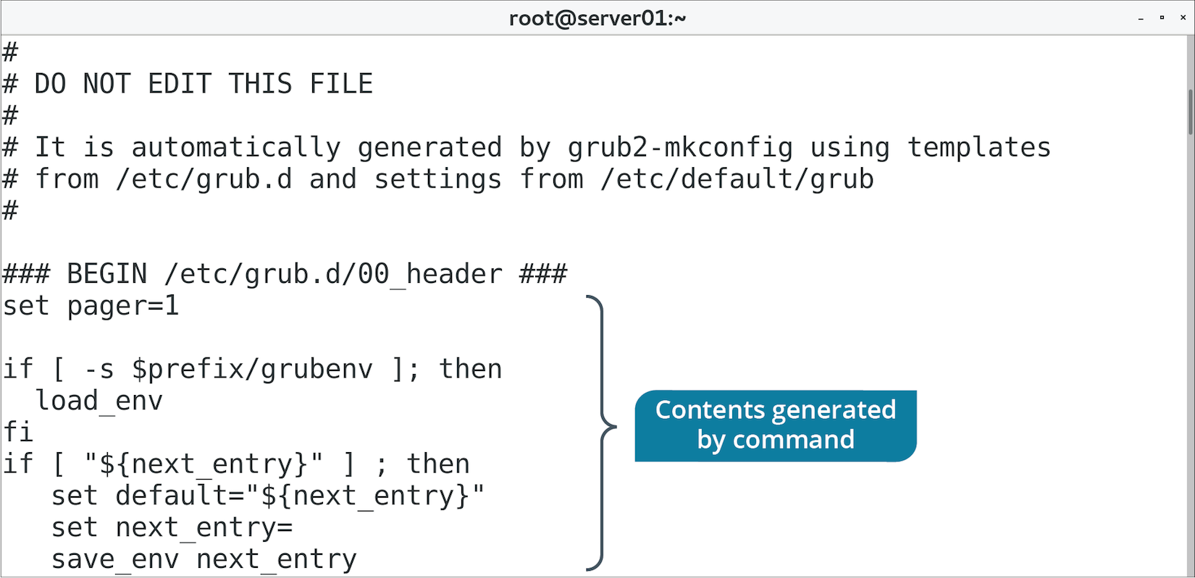
The grub.cfg File (Slide 2 of 2)

Slide 36
The /etc/grub.d/ Directory
Contains scripts used to build main grub.cfg file.
Each script provides various functions to GRUB 2.
Each script is numbered so it can be executed in order.
Not a good idea to edit existing scripts.
You can create your own and add them here.
Name them with ##_ prefix to execute in desired order.
Or, add scripts to 40_custom to execute last by default.

Slide 37
GRUB 2 Boot Menu Customization (Slide 1 of 2)
/etc/grub.d/40_custom enables customization of boot menu.
Boot menu offers user choice of which installed OS to boot from.
Multi-boot.
Boot to different kernel versions.
Boot to rescue mode.
Customization options:
Order of menu choices.
User-friendly names.
Password protection.

Slide 38
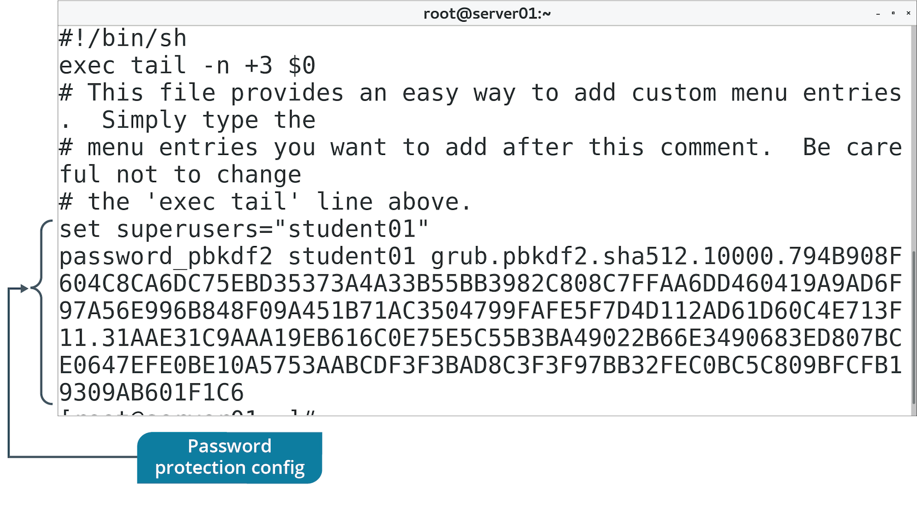
GRUB 2 Boot Menu Customization (Slide 2 of 2)

Slide 39
The /etc/default/grub File (Slide 1 of 2)
Contains display menu settings.
Read by /etc/grub.d/ scripts and built into grub.cfg file.
Enables you to change options such as:
How many seconds until GRUB 2 auto-selects default boot option.
Placement of kernel versions in sub-menus.
Display menu in graphical terminal.
And more.

Slide 40
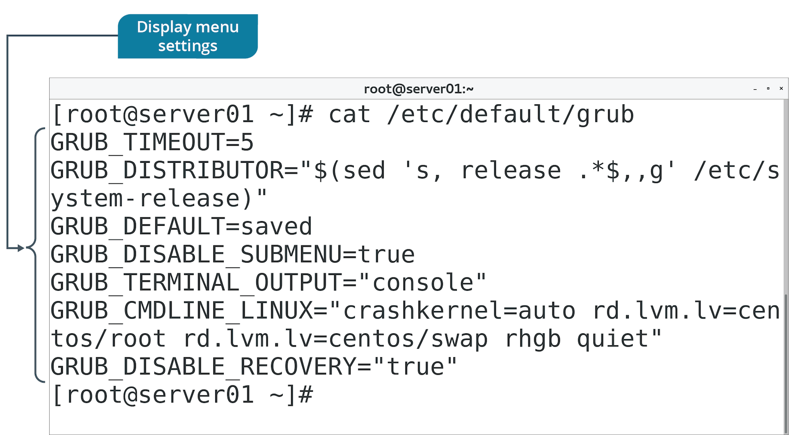
The /etc/default/grub File (Slide 2 of 2)

Slide 41
The grub2-mkconfig Command
Generates a new grub.cfg file.
Or, updates existing grub.cfg file.
Combines:
Configuration templates in /etc/grub.d/
Settings in /etc/default/grub
Uses both to generate grub.cfg file.

Slide 42
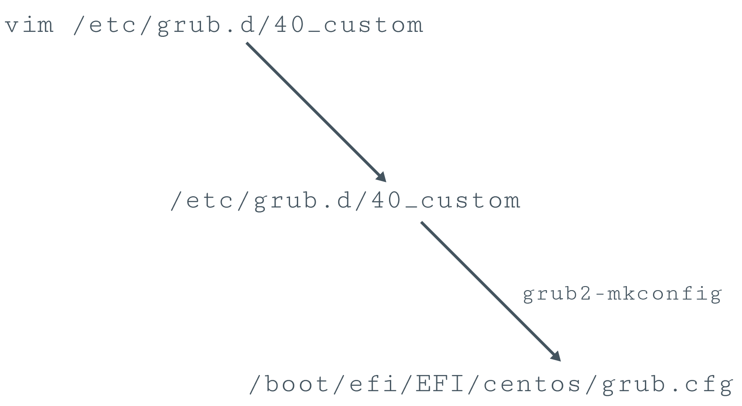
GRUB 2 Configuration Process (Slide 1 of 2)

Slide 43
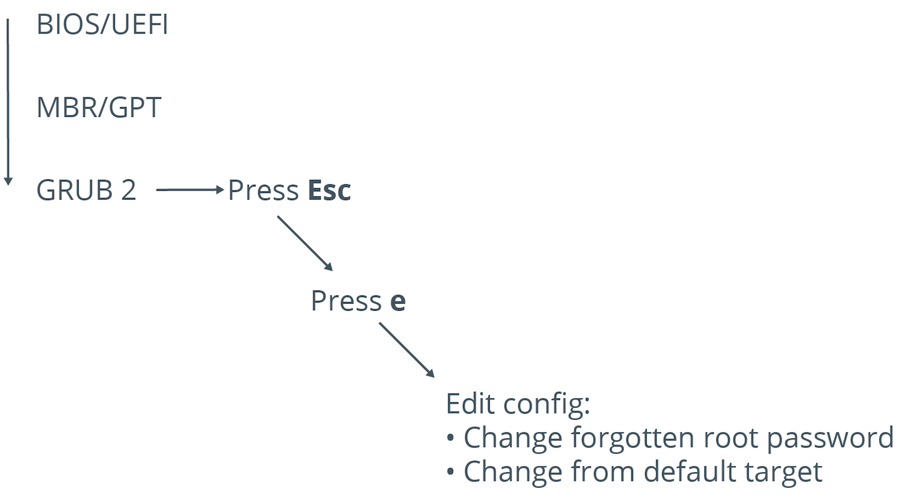
GRUB 2 Configuration Process (Slide 2 of 2)

Slide 44
Discussing GRUB 2

Slide 45
Activity 7-4: Discussing GRUB 2
You want to create a bootable DVD-ROM Linux distribution for some kiosk computers that customers will use to look up products while in your retail locations. Which new GRUB 2 improvement makes this an easier task compared to a few years ago?
ANSWER:
Support for live booting makes it easy to run the OS entirely in memory without installation.

Slide 46
Activity 7-4: Discussing GRUB 2
You decided to make all your systems more secure by adding a GRUB 2 boot loader password. After making the change to multiple systems, you feel confident that the new security measure will be effective in securing your systems. Which command can you use to generate a password for GRUB 2?
ANSWER:
grub2-mkpasswd-pbkdf2

Slide 47
Activity 7-4: Discussing GRUB 2
You have tasked a junior administrator with adding a single boot loader option to three of your Linux systems. The administrator lets you know that he was unsuccessful at making the changes because he received a permission denied error. What is the issue?
ANSWER:
The administrator must have superuser privileges to create a new GRUB 2 custom menu file.

Slide 48
Activity 7-4: Discussing GRUB 2
How can you edit the GRUB 2 boot loader during the boot process?
ANSWER:
You start or reboot the system, then, on the GRUB 2 boot menu press Esc. Next, highlight one of the entries, press e, edit the configuration, then press Esc. Finally, press Enter to boot using your option.

Slide 49
Activity 7-4: Discussing GRUB 2
What are some examples of changes you could make to the default GRUB 2 menu?
ANSWER:
You could change options such as how many seconds GRUB 2 will wait before automatically selecting the default boot option; whether or not GRUB 2 will order kernel versions in a sub-menu; whether or not GRUB 2 will display the menu in a graphical terminal; etc.

Slide 50
Activity: Configuring GRUB 2
Some Linux servers aren't booting properly.
You need to troubleshoot.
Someone modified boot loader settings.
You corrected the boot loader.
Now you need to password protect GRUB.
Notes:
Teaching Tip: This activity assumes that students' systems are using UEFI and that there is an EFI system partition installed. Steps will vary if they are using systems with older BIOS firmware.
Teaching Tip: Hashing is discussed in more depth in a later lesson.
Teaching Tip: Assist students with this step as needed.

Slide 51
What boot options do you use or plan to use in your Linux environments? Why?
Do you anticipate the need to configure GRUB 2 in your environments? Why or why not?

